Slide 1
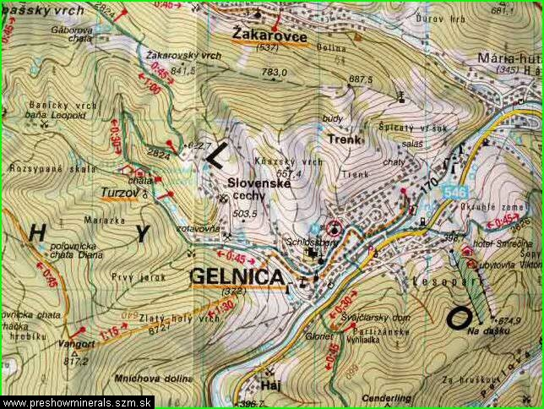
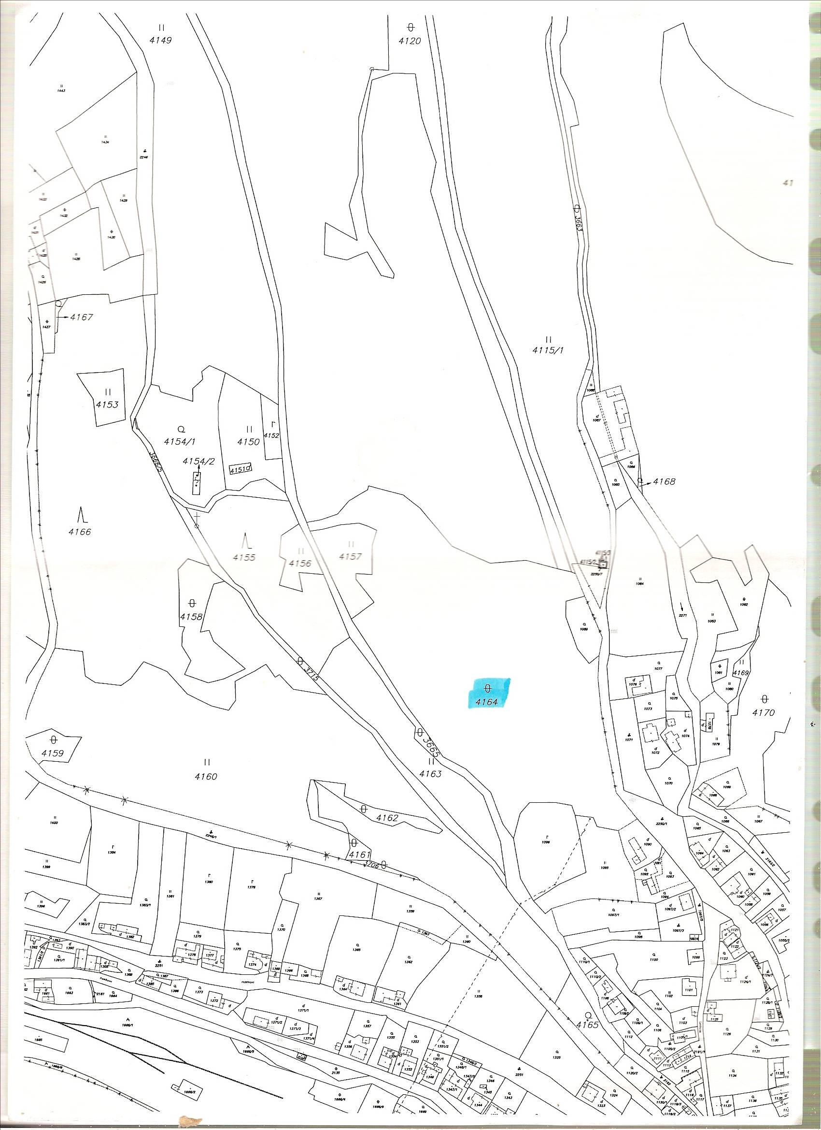
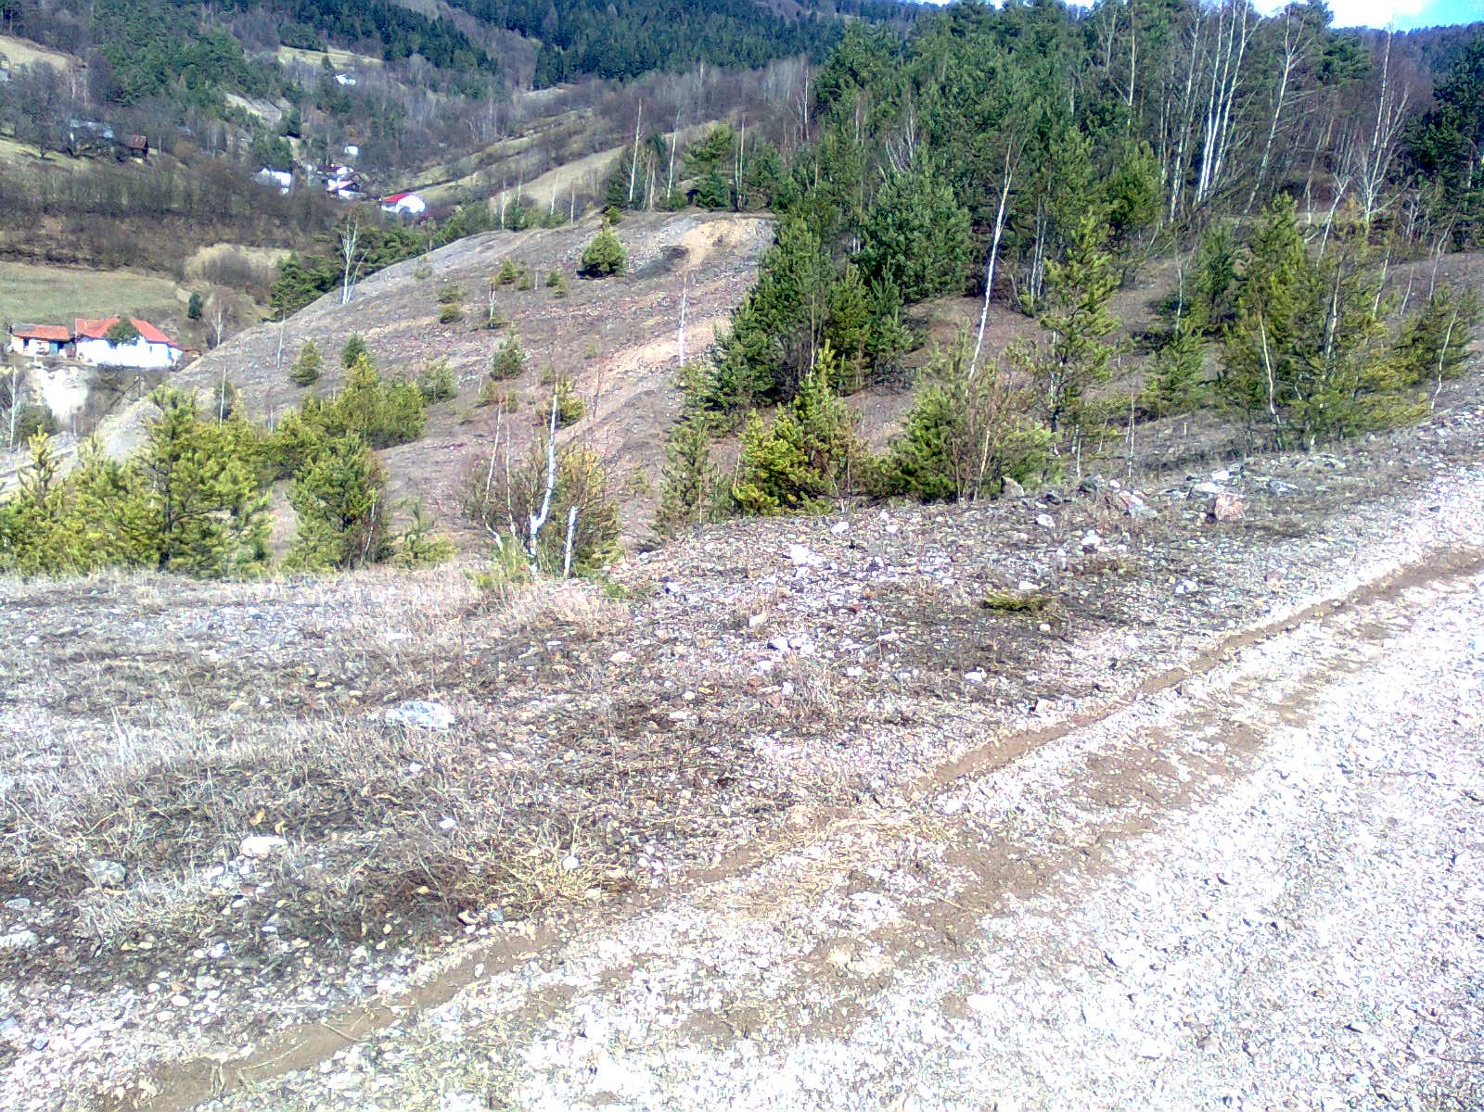
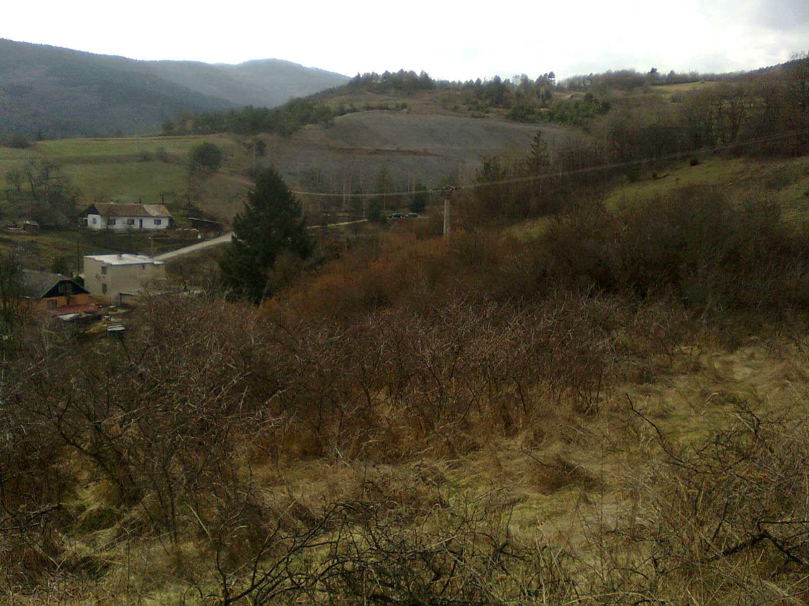
Abstract The spoil heaps after mining are weighed after extraction of ores, which are the remains of the low effective medieval mining ores and they represent a permanent environmental impact. Our project deals about analysis of secondary complex of mining remains on area of ​​approximately 5 500 m² in the locality Slovenské Cechy – Gaple in the Košice region of Eastern Slovakia. Mentioned area is characterized by high content of copper and also of iron, arsenic, lead, zinc and antimony in soil. Project presents characteristics of environmental conditions on the spoil heap in Gelnica, pH of soil properties, description of vegetation and settlement on this spoil heap, and representatives of fungi and animals. Our results shows presence of content of toxic metals in the lichen Cladonia arbuscula subsp. mitis in relation to their high content in the soil of spoil heap. Transferred phytocenological vegetation records represent typical population of central and peripheral part of the spoil heap. Results of our observations show that the most widespread species in spoil heap in Gelnica include Agrostis capillaris and lichens Cladonia arbuscula subsp. mitis and Stereocaulon dactylophyllum. Total vegetation cover of the heap is about 40%. Although the incidence of individuals lichen genus Stereocaulon abundant on the heap, are among the endangered and critically endangered species. Individuals present in higher plants are characterized by obvious signs of impaired vitality. The soil is characterized by acidic pH of the heap, we measured value 5.1. In terms of fauna on the heap, we observed occurrence of mainly invertebrates. The most frequent lichen Cladonia arbuscula subsp. mitis, we determined the content of toxic metals and found that lichens were most represented by the elements aluminium, iron, antimony and copper. In a contrasting view on the heap as a source of potentially hazardous toxic metals, as well as a place that wants a wide range of endangered and rare lichens, spoil heaps deserve our attention - perhaps as educational geological trail, which will include and serve to all.
Introduction
The spoil heaps are weighed after extraction of ores, occurring in various areas of central and Eastern Slovakia. Portions are waste material from deep mining - jalovinu, ie rocks that had economic significance. The district is the occurrence of Gelnica heaps are most localized around the site Gelnica Slovenské Cechy, Thurzov, Smolník and Smolnícka Huta. The work deals with the geological characteristics of the heap in Gelnica in locality Slovenské Cechy, the presence of toxic metals in the substrate, the pH of soil properties and description of vegetation and settlement representatives of fungi on the heap, and also deals with animals, whose manifestations of life in some way related to this heap. I have been devoting my time to study of heap area in Gelnica in locality Slovenské Cechy-Gaple already two years, but its transformation traced back to childhood, as grandparents live in the nearby vicinity. The main reason for selecting this theme is my interest in ecology, because it is a highly topical issue and also the history that this heap literally breathes.
The aim of work:
- to describe specific, geological composition and content of the spoil heap of toxic metals in the substrate in a spoil heap in Gelnica in locality Slovenské Cechy-Gaple,
- to determine the acid-base properties of the soil of spoil heap, to describe the environmental conditions, species of vegetation of central and peripheral part of the heap,
- to determine the dominant modes and convert phytocenological records representing the central and peripheral part of the spoil heap,
- to identify the types of fungi that grow on this spoil heap, to identify species whose environmental effects are associated with permanent, resp. temporarily staying up on this spoil heap,
- to determine the levels of toxic metals in the insole most frequent lichen species Cladonia arbuscula subsp. mitis growing on the spoil heap in Gelnica in locality Slovenské Cechy-Gaple,
- to compare the metal content in thalus of the lichen species with metals, which are present in the substrate of spoil heap.
Matherial and Methods
Gelnica is an old mining town in the Košice region of Eastern Slovakia. History of the town is closely connected with mining, mainly copper and iron ores, including silver, mercury, lead and gold also in the locality Thurzov and Zenderling.
4164
Fig.1 Locality Slovenské Cechy – Gaple near Gelnica
Fig.2 Area of spoil heap
Metals mining and processing of wastewater material, which is largely exported from the mines to open areas. In connection with the exportation of waste slag heap was also portrayed in Gelnica site in Slovenské Cechy - Gaple, which therefore represents a secondary complex. According to data from the Mining Museum in Gelnica, is spoil heap about 200 per year rather large stony complex area of ​​approximately 5500 m² and is composed mainly of schist, quartz, siderite, chalcopyrite, pyrite, tetraedrit, to a lesser extent also secondary minerals of copper – limonite, malachite, azurit, olivenit, antlerit, cornwallit and other types of minerals. Spoil heap area is situated mostly in the local part Slovenské Cechy, but part of it extends beyond.
Fig. 3 Looking for spoil heap from locality Slovenské Cechy
Fig. 4 Looking for spoil heap by Gelnica

Slide 2
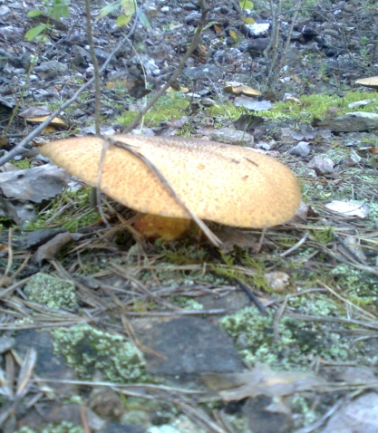
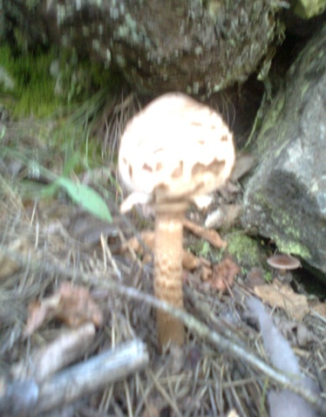
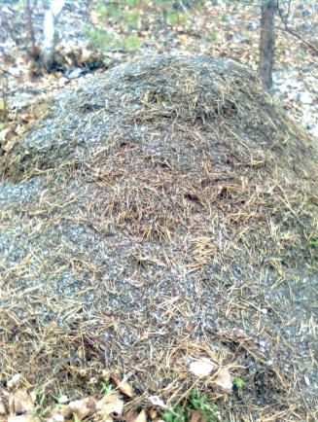

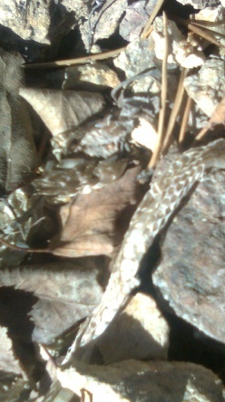
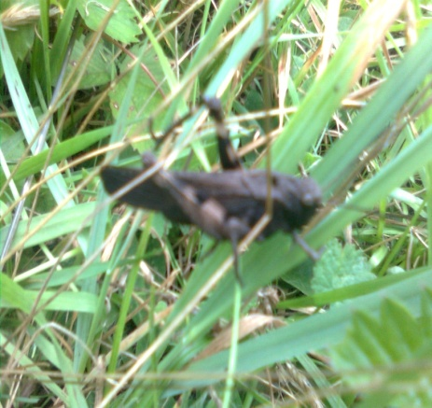
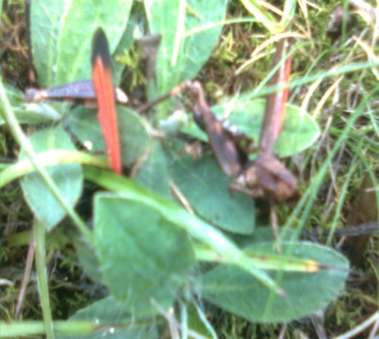
Table 3 List of fungi growing on the heap in the area of ​​Slovak Gelnica Guilds
Species of funfi | Peripheral part | Central part
Suillus luteus | + | +
Leccinum scabrum | + | +
Lactarium torminosus | + | -
Leccinum thalassinum | - | +
Boletus edulis | + | -
Amanita muscaria | + | -
Macrolepiota procera | + | -
Russula nigricans | + | -
Fig.14 Suillus luteus Fig. 15 Macrolepiota procera
2.6 Fauna of spoil heap
Similarly, as the selected group of plants and lichens, which are able to exist in extreme conditions described herein, a heap inhabit the xerophilous and thermophilous species, mostly from groups of invertebrates. As the strict boundaries of the heap environment of grassland ecosystems is not in any smooth migration barrier, I had the opportunity to observe the movement of mammals as the Capreolus capreolus and very common hare Lepus europaeus. The spoil heap is for these animals a kind of bio-corridor among the surrounding grassy meadow ecosystems and there is a conflict here fauna of both types of ecosystems, so often we can watch of horses, butterflies as well as other species, although their presence is permanently bound to meadowy ecosystem. Permanent invertebrates on the spoil heap are especially ants, and I watched the earth nest type of Vespa crabro. From group of Vertebrates – Reptiles Lacerta muralis and Vipera berus live on the spoil heap.
Fig.16 The anthill of Forica rufa Fig.17 Inachis io Fig.18 Snake skin of Vipera berus
Near the spoil heap, although its occurrence is unrelated to a pile in direct connection, I have documented the occurrence of Psofus stridulus, whose presence on that unit has not been described yet.
Fig.19 Individual of Psofus stridulus - right dead bird
Table 4 Animals whose life symptoms related to their presence on the spoil heap
Animal species | Permanent presence | Temporary presence | Particularities of living speech
Invertebrates: Pyrrhocoris apterus | + |  | very frequent occurrence, even in the central and peripheral parts of the heap
Vespa crabro | + |  | found earth nest
Oniscus asellus | + |  | frequent occurrence, mostly under rocks in the central part
Formica rufa | + |  | migration in the central part of the anthill in the peripheral parts
Tettigometra obliqua |  | + | active movement of the spoil heap
Geophilus sp. | + |  | requent occurrence, mostly under rocks in wetter parts of the peripheral
Inachis io |  | + | active movement of the spoil heap
Lacerta muralis) | + |  | active movement in the central part of spoil heap
Chorthippus montanus |  | + | active movement of the spoil heap
Chorthippus biguttulus |  | + | active movement of the spoil heap
Oedipoda caerulescens |  | + | active movement of the spoil heap
Anatis ocellata | + |  | active movement of the spoil heap
Vertebrates: Vipera berus | + |  | observed movement of the cranberry growing heather and bilberry - found snake skin
Lepus europaeus |  | + | observed dropping, active movement of the spoil heap
2.8 The metal content in lichen Cladonia arbuscula subsp. mitis
Given the high percentage of toxic metals in the substrate of spoil heap, and also study of the information about the ability of lichens to accumulate metals from the environment in which grown, we investigated the presence and amount of accumulated metals in the insole of most frequent lichen species Cladonia arbuscula subsp. mitis. Observed the metal content in this lichen species is presented in Gr.1.
The total content ( μg/g s.hm.)
Cu Zn Pb Ni Co Al Fe Sb
Gr.1 The total content of toxic elements in the lichen Cladonia arbuscula subsp. mitis
The most representative element in moss was aluminum, the other in the order are iron, copper and antimony. The lowest metal content was observed in the case of the elements nickel, lead and cobalt.
Disscusion
Discussion Spoil heaps are different from natural habitats containing high amounts of toxic metals, harsh conditions such as lack of water and humus settlement and also only a narrow group. Weathering and debris creating of humus runs very slowly (Banásová, 2003), in which the complex set of conditions associated with the slow settlement and overgrowing vegetation. As for the color of slag heap, spoil heap on the site in Gelnica in the locality Slovenské Cechy - Gaple is characterized by blue-gray color. Colour variation in debris in Smolnícka Huta is characterized by ocher color.
The pH value of soil of spoil heap in Gelnica is 5.1. This value is correlated with the finding Banásová (2003), whereby the measurement of soil pH properties of debris from the historic copper mining in Smolnícka Huta is pH value 4.8. Acidic soil pH is due to the presence of large amounts of sulphides in the slag.
According to Banásová (2006), spouheaps of anomalous metal content (Old Mountain, Gelnica, Smolník) are a kind of ecological islands, as compared with the surroundings have a very specific vegetation. Over many decades, the natural evolution of plants excluded (immigrants) who did not have an adjustment capability and the end result of this development is a small group of plants - mosses, lichens, grasses and herbs such as Ceratodon purpureus, Cladonia arbuscula subsp. mitis, Cladonia pyxidata, Lecanora subaurea, L. Handeli, Stereocaulon nanodes, S. incrustatum, Agrostis capillaris, Agrostis stolonifera, Avenella flexuosa, Anthoxanthum odoratum, Festuca rubra, Silene vulgaris, Silene dioica, Acetosella vulgaris, Arabidopsis arenosa, Thlaspi caerulescens, Calluna vulgaris and Dianthus carthusianorum. According to our findings, the typical plant species occurring on the spoil heap in Gelnica are just some of the author of these species, namely Agrostis capillaris, Cladonia arbuscula subsp. mitis, Silene vulgaris, Acetosella vulgaris, Calluna vulgaris, Dianthus carthusianorum. Species such as Agrostis stolonifera, Avenella flexuosa, Anthoxanthum odoratum, Festuca rubra, Silene dioica, Arabidopsis arenosa Thlaspi caerulescens, we us the described spoil heap ever been recorded. On the spoil heap in Slovakia found their habitat as well several rare and endangered species of lichens (Pišút et al. (2001)), in our case we have specific categories of Vulnerable reported the presence of species of Stereocaulon - Stereocaulon tomentosum, and type S.dactyllophylum, Cladonia furcata.
The presence of lichens in large quantities on the spoil heap according to the authors explains Lange and Ziegler (1963) the fact that, as pioneers in these areas do not have their optimum, but in comparison with other species are competitively strong.
Regarding the metal content found in most commonly occurring lichen Cladonia arbuscula subsp. mitis, we found that moss accumulated in the order of the highest amounts of aluminum, iron, antimony and copper. If we compare the content of elements accumulated by lichens containing toxic metals present in the soil heap found by Banásová (2006), whereby the slag are elements in the order Fe>> Cu>> As> Sb> Pb> Zn, we can conclude that moss accumulated high levels mainly on those elements (except aluminum), which are located in the slag in the highest quantity.
Conclusion
In terms of analysis, synthesis of the spoil heap in Gelnica in the locality Slovenské Cechy - Gaple derive the following conclusions:
•settlement of the heap is limited to the species (including the frequency and coverage)
•soil heap characterized acidic pH,
•the total vegetation cover of the heap is about 40%,
•the most widespread type of heap after the historic mining ore in the locality Slovenské Cechy-Gaple is Agrostis capillaris
•frequently represented species are also Betula pendula and Pinus sylvestris with obviously impaired vitality
•frequently occurring species are lichens on the spoil heap - the most common type of Cladonia arbuscula subsp. mitis and Stereocaulon dactylophyllum,
•on the spoil heap, we have seen representatives of the eight kinds of fungi - the most abundant of fungi is Suillus luteus and occurs predominantly in the central parts of the spoil heap,
•the vast majority of species inhabiting permanent heap belongs to a group of invertebrates,
•the most representative elements in the lichen Cladonia arbuscula subsp. mitis were aluminum, iron, antimony and copper,
• the presence of toxic metals in lichen insole analyzed and related agrees with the content in the soil of the spoil heap.
The settlement of the rock debris relates to the heap breaking under the influence of weather conditions and also with the formation of humus, which is generated by decomposition of organic material from plants first inhabited, resp. lichens. Occurrence of inventoried species settling spoil heap shows the gradual overgrowing heap towards the edge of the species towards the wealthier segments in the central species poorer parts.
In the future I want to explore this historic spoil heap and continue to monitor its successional conversion in the longer term. I would like to explore the nearby the spoil heap in Smolnícka Huta, each to compare spoil heap and to generalize the findings. Because the spoil heap is close to the human settlements and underneath spewing fountain, from which it takes a day for drinking locals, I would like to see the content of toxic metals in the water. Because of the mining tradition and also because it is occurring on the heap protected by lichens and the slag is a large amount of minerals, consideration calculates the route for educational geological trail and thus draw attention to delights which spoil heap can offer.

